Slide 1
Market Mix Model - Eleckart
Capstone Project
Name:- Divit Karmiani
Email ID:- divitkarmiani1998@gmail.com

Slide 2
Problem Overview
Company Overview
ElecKart is a leading e-commerce chain based in Ontario, Canada, specialising in electronic products. It sells all major electronic items such as TVs, cameras, OLED screens, and microwaves. The company follows the marketplace model and acts as a platform where buyers and sellers can interact with each other. Sellers can put various products on the website, and buyers purchase these products from them.
The company has a huge network across the country and has partnered with multiple courier companies to deliver their products to customers in every possible corner of the country. It sells these products only via the website and occasionally offers big-ticket promotions (similar to the Big Billion Day) in order to ensure that the top-end customers are delighted.
The brand has shown commendable growth in just a few years of its operation. However, over the last one year, ElecKart has faced a revenue dip even after spending a significant amount of money on marketing and promotions.
Business Objective
To develop a market mix model for ElecKart for 3 product sub-categories - Camera Accessory, Gaming Accessory, and Home Audio based on the given information and the data sets related to consumer purchases, monthly spends on advertising channels, climatic information and the NPS/stock index.
To observe the impact of various marketing variables over a period of one year - July 2015 to June 2016
Recommend optimal budget allocation for different marketing levers for the upcoming year

Slide 3
Data Description
Given Datasets
4P’s of Marketing
Daily order details of consumers
Investment details for the past year with details of amount invested in each medium
Sale Calendar showing dates for promotional offers over the past year
Net Promotion Score(NPS) and Company Stock Value for the last year
Weather reports from last year in Ontario, Canada
# units sold
Pin code
Delivery days and SLAs
Order Payment Type
Categories/Sub-categories
Week of the year
Product
Place & Time
Verticals
Holiday/ Seasonality
Procurement SLA
Sale Calendar
4 P’s of Marketing
GMV
Marketing Channel Investments
Product MRP
Price
Promotion
Customer Sentiment(NPS)
Discounts
Adstocks

Slide 4
Analysis Approach
Data Preparation
EDA
Exploratory Data Analysis
Model
Building
Model Evaluation
Feature
Engineering
Data Preparation involves various steps like data cleaning, removing duplicates, removing unnecessary columns, outlier treatment, etc
Since there are many different datasets, this step is of utmost importance as it involves combining the datasets and getting them ready for further use
Most of the times, the data that is given in the various datasets is not enough to convey the right information and use it for modelling
Feature engineering is the process of using domain knowledge to extract features from raw data
Exploratory Data Analysis is the process of performing initial investigations on data to discover patterns,spot anomalies, test hypothesis, etc with the help of summary statistics and graphical representations.
Here we do univariate, bivariate, and multivariate analysis
In our case, we use various Linear Regression Models
Simple Linear Regression - Additive and Multiplicative
Kyock Model
Distributed Lag Model - Additive and Multiplicative
After trying out various models, we will select the best fit model based on the accuracy scores of each model
We will then use the predictions by the selected model to make recommendations for the given use case

Slide 5
Data Preparation

Slide 6
Data Preparation
Data Cleaning
Data Pre-processing
Outlier Treatment
Merging with other datasets
1
Fixing Invalid Values
1
Pre-processing of numerical columns
1
Removing Outliers for Product_mrp
1
Data Cleaning of other datasets
2
Sanity checks
2
Pre-processing of categorical columns
2
Outlier Treatment of #Units
2
Extracting 3 separate dataframes for each product subcategory
3
Treating Missing Values
3
Removing duplicates and unnecessary data
3
Removing Outliers for SLA
3
Extract Weekly data for the 3 subcategories
4
Merging with other dataframes
To get more details on the data preparation process, go to Appendix

Slide 7
Feature Engineering

Slide 8
Feature Engineering
Additional Columns Created
Week number - Week number is extracted from the Order Date
Is_paydate - If the order_date is First or Fifteenth of a month, then is_paydate = 1 or is_paydate = 0
Is_holiday - If the order_date is a Holiday in Canada, then is_holiday = 1 or is_holiday = 0
KPIs for Consumer Electronics data
KPIs for Media Investment Data
KPIs for Combined Data
List_Price - GMV / #units
Discount_Percent - (product_mrp - list_price)*100/product_mrp
Product Type (Luxury/MassMarket) - If GMV value is greater than 80 percentile, then luxury, else mass_market
SMA (Simple Moving Average) and EMA (Exponential Moving Average) of the investment for the each of the marketing levers
Adstock - The formula for adstock is At = Xt + adstock rate * At-1
Payday Week - If it is a Payday week then 1 else 0
Holiday Week - If it is a holiday week then 1 else 0

Slide 9
Exploratory Data Analysis

Slide 10
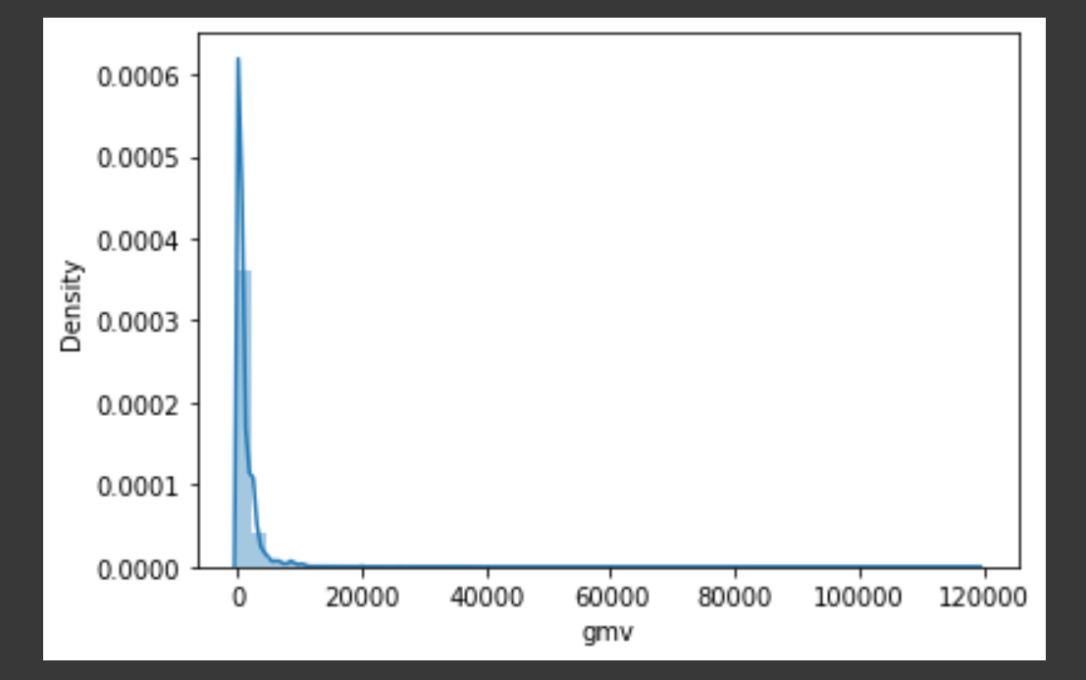
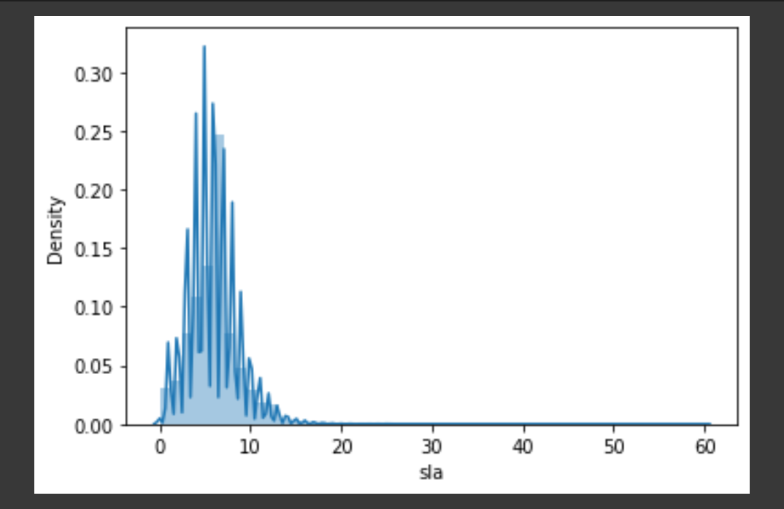
Univariate Analysis - Numerical Columns

Slide 11
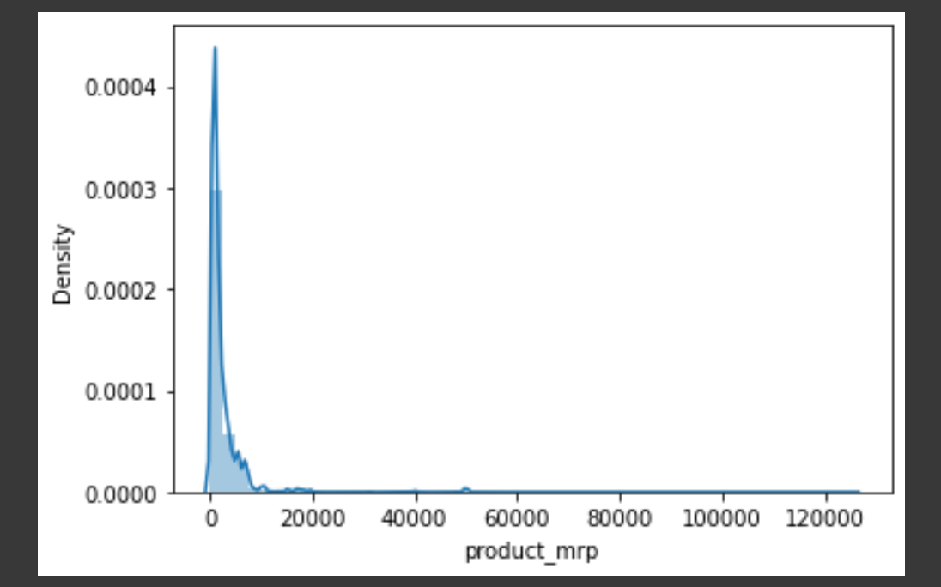
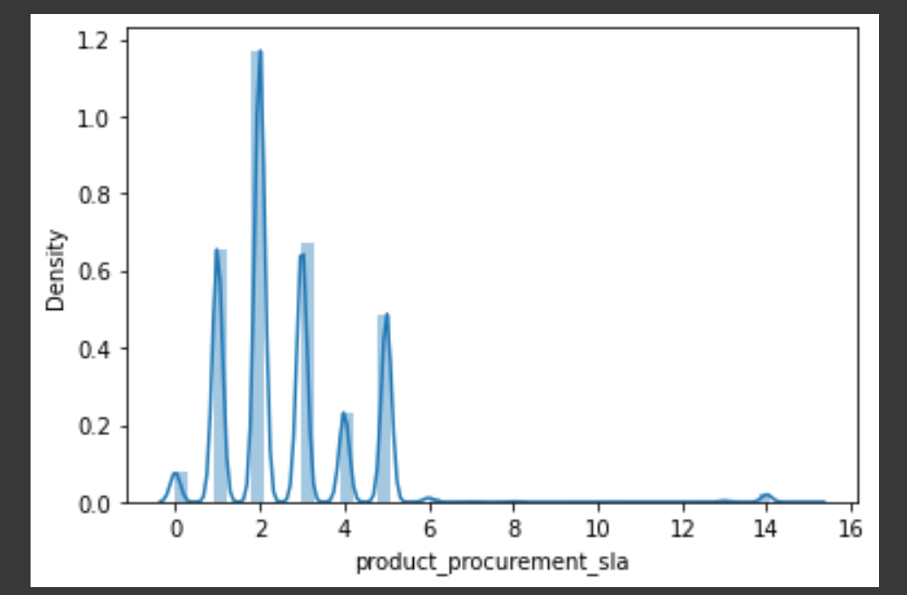
Univariate Analysis - Numerical Columns

Slide 12
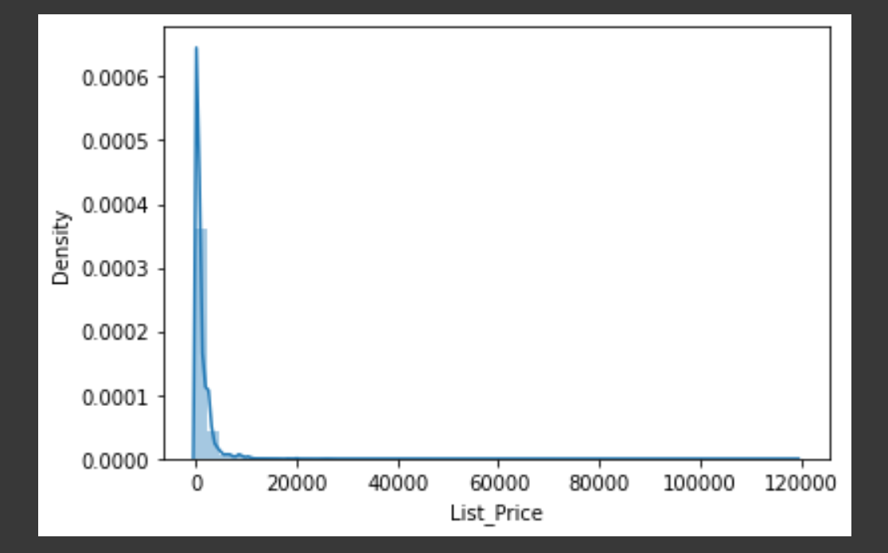
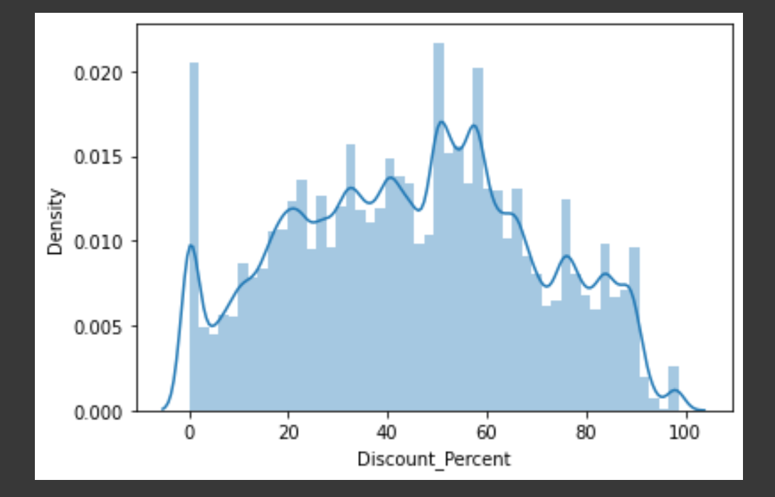
Univariate Analysis - Numerical Columns

Slide 13
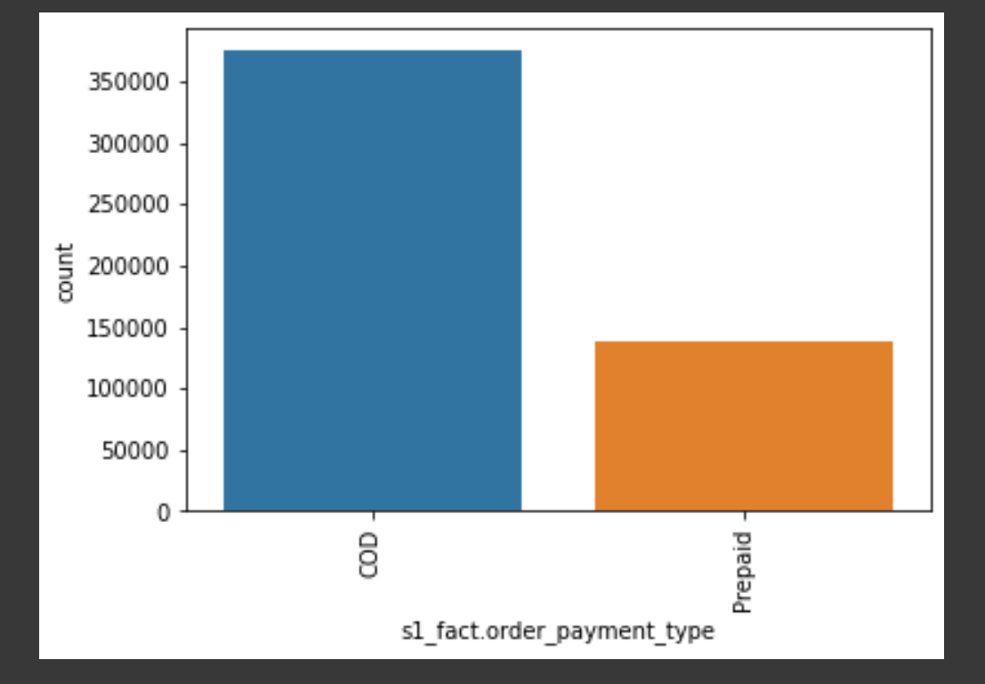
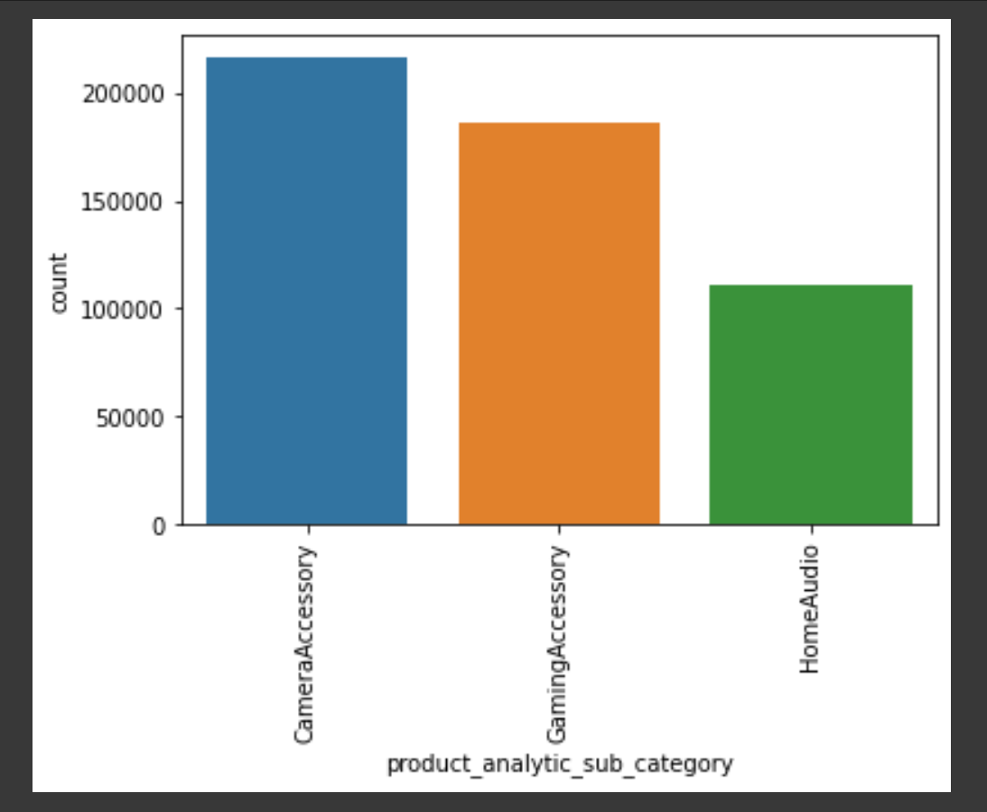
Univariate Analysis - Categorical Columns

Slide 14
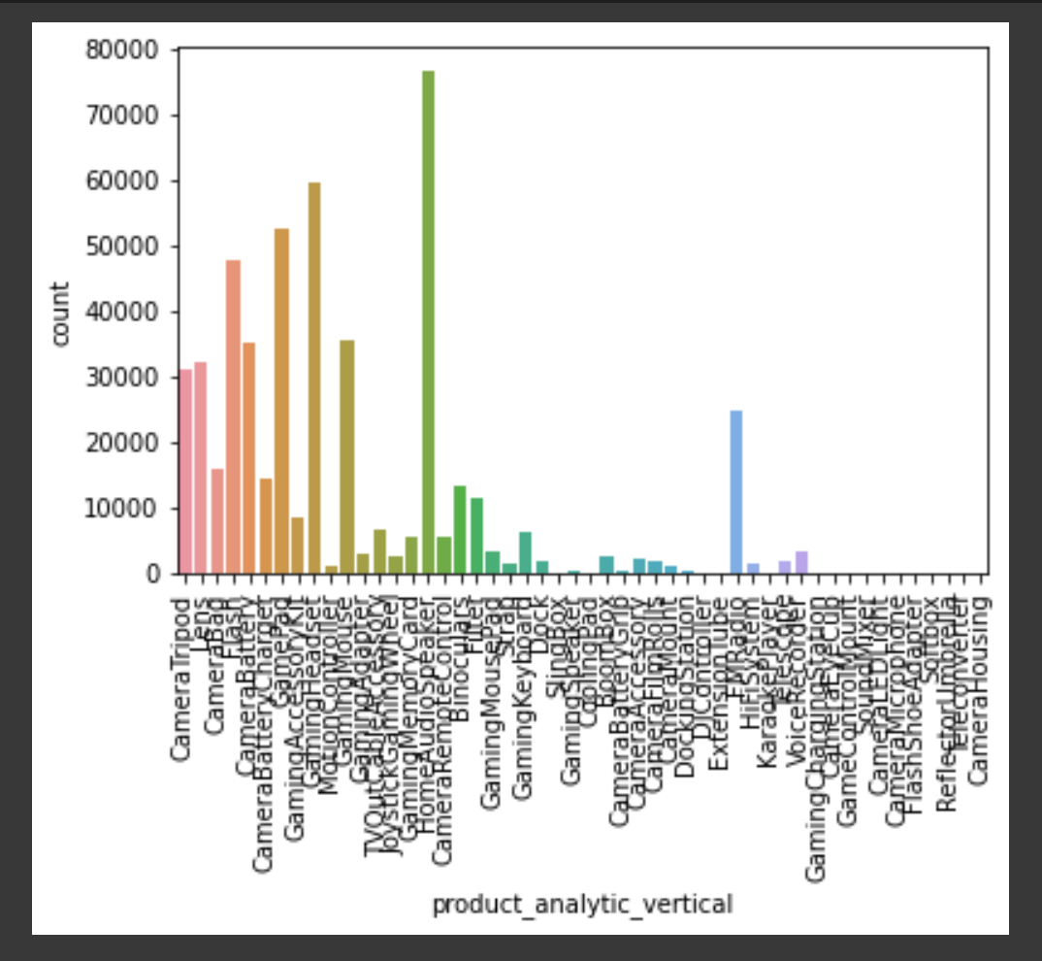
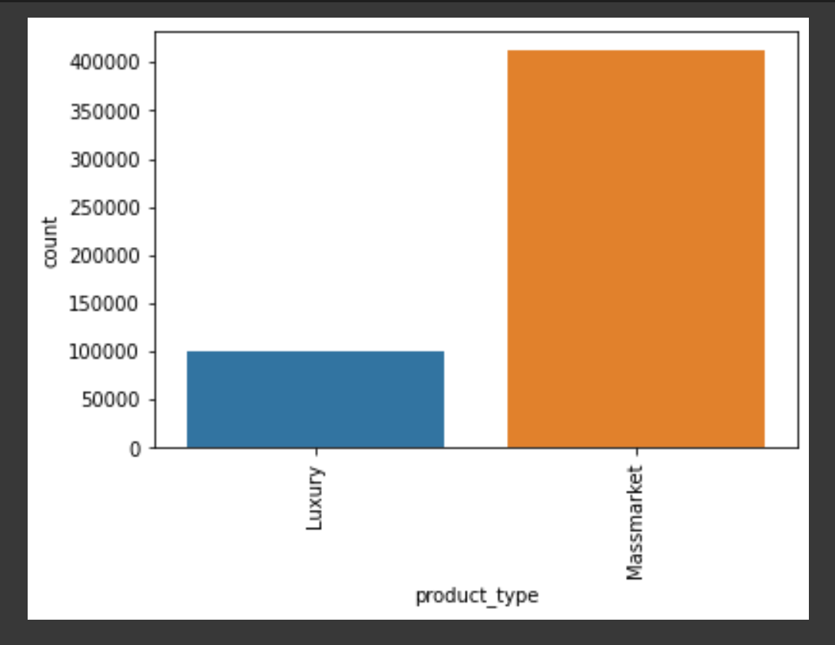
Univariate Analysis - Categorical Columns

Slide 15
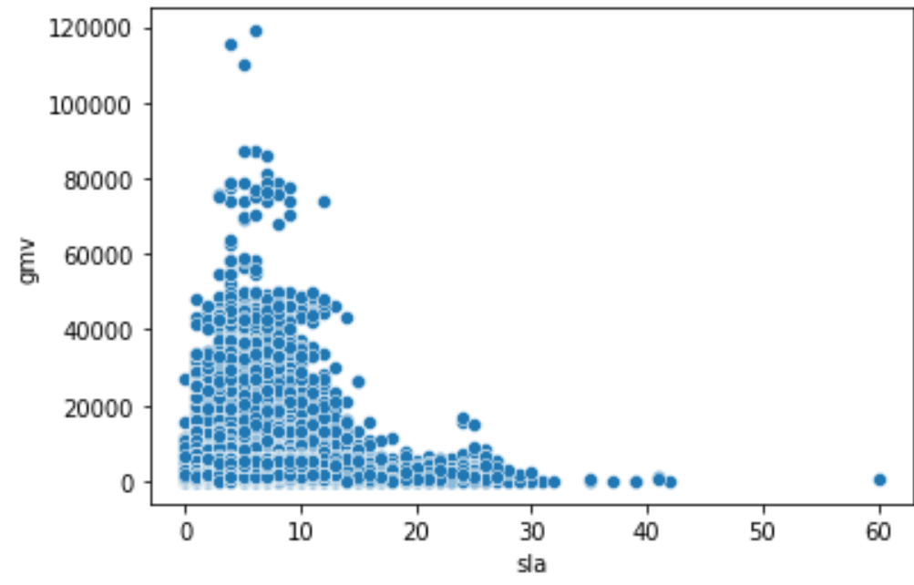
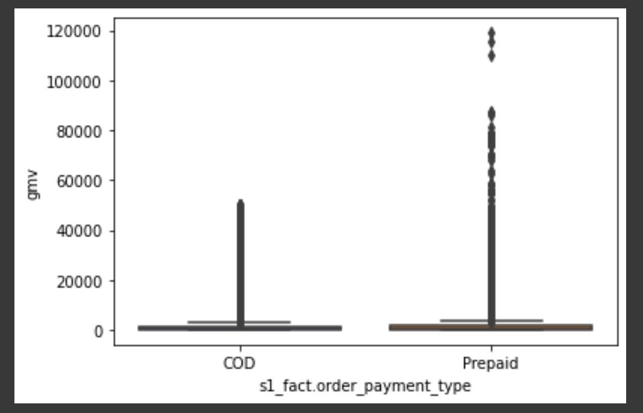
Bivariate Analysis

Slide 16
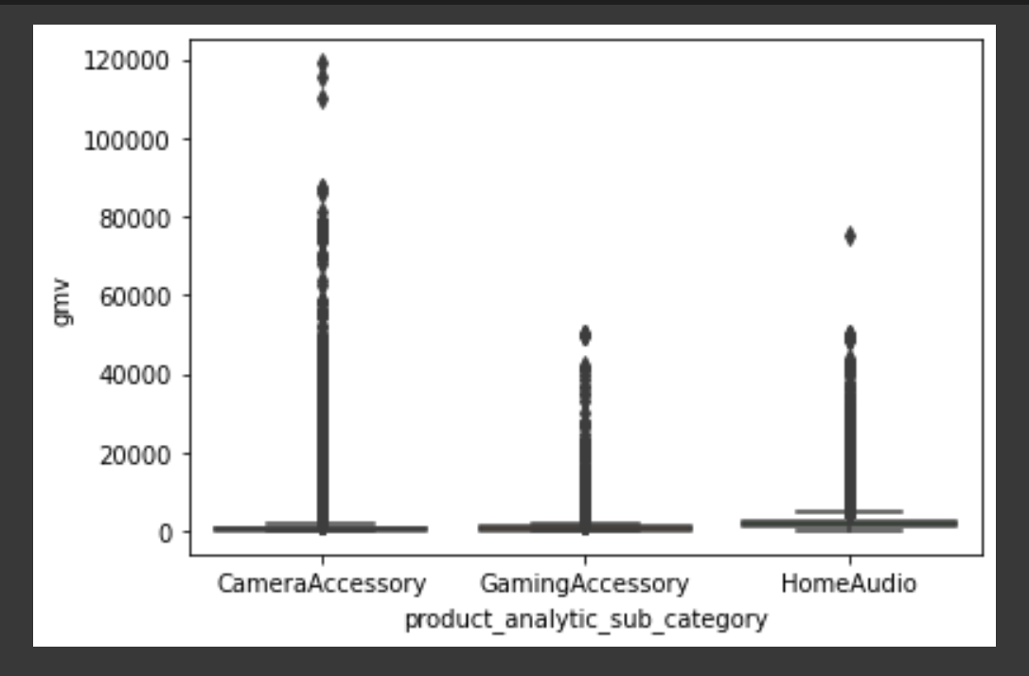
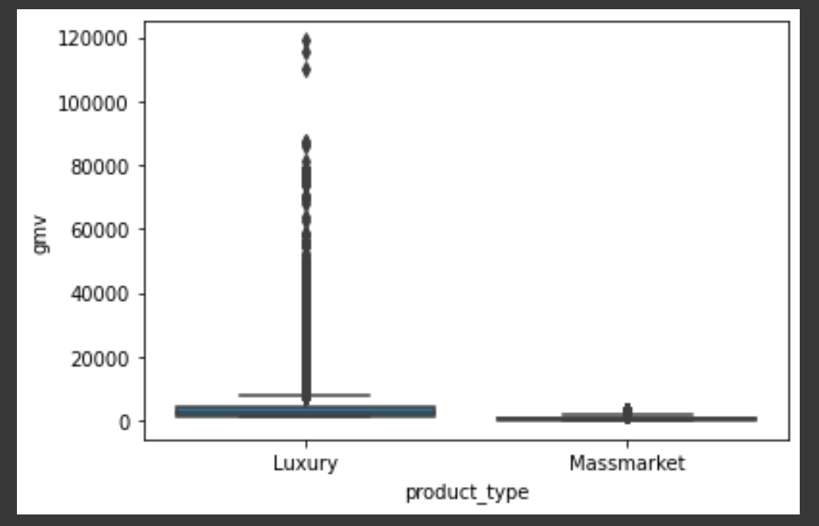
Bivariate Analysis

Slide 17
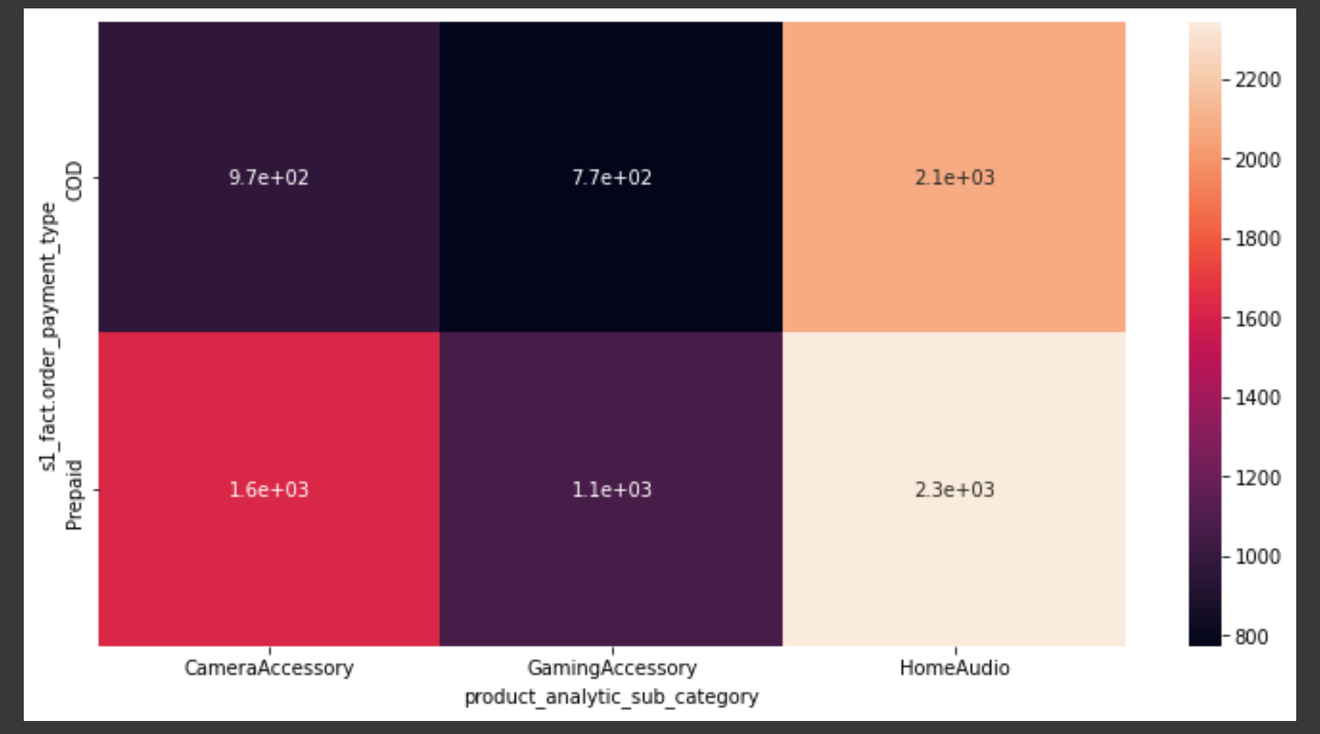
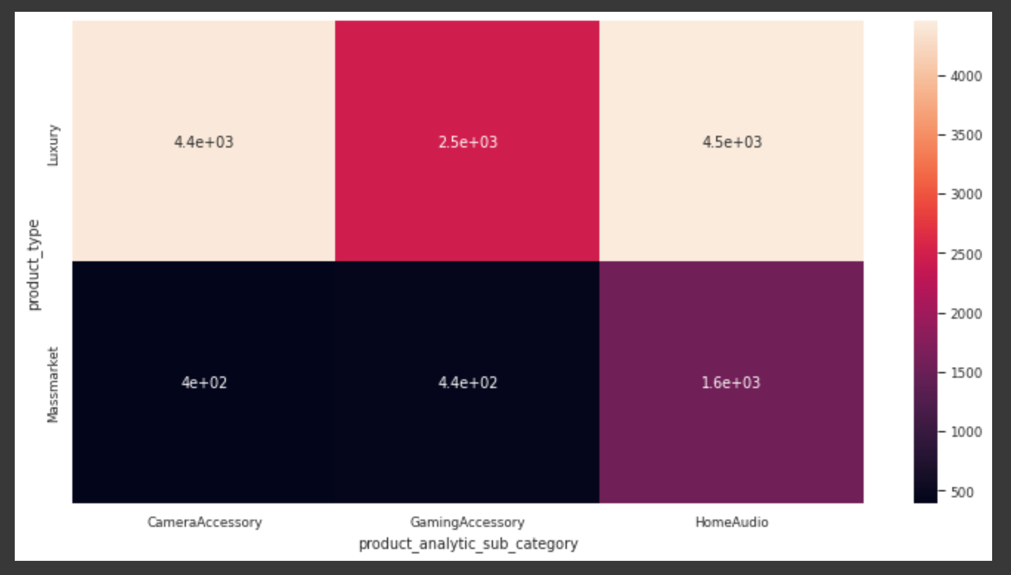
Multivariate Analysis
gmv vs s1_fact.order_payment_type vs product_analytic_sub_category
gmv vs product_type vs product_analytic_sub_category

Slide 18
Model Building

Slide 19
Description of Models
Linear Regression (Additive) - Linear model is used to observe the current effect of several KPIs. This model assumes an additive relationship between the different KPIs. Hence their effect is also additive towards the dependent Y variable
Linear Regression (Multiplicative) - Multiplicative model is used when there is interaction between the KPIs. To fit a multiplicative model take logarithms of the data
Koyck Model - Koyck model is used to capture the carry-over effect of different KPIs, i.e. to model the current revenue figures based on the past figures of the KPIs. The model tells us that current revenue is not influenced by the different independent attributes, but also because of the revenue generated over the past periods
Distributed Lag Model (Additive) - In the distributed lag model, not only is the dependent variable, but the independent variable is entered in its lagged version. This is a more generalized model and captures the carry-over effect of all the variables
Distributed Lag Model (Multiplicative) - This model will help us capture the interactions between current and carry-over effects of the KPIs

Slide 20
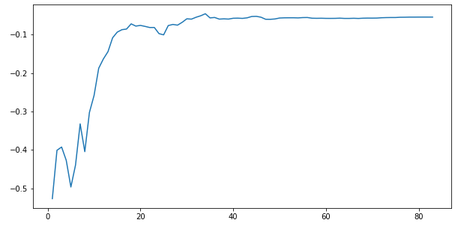
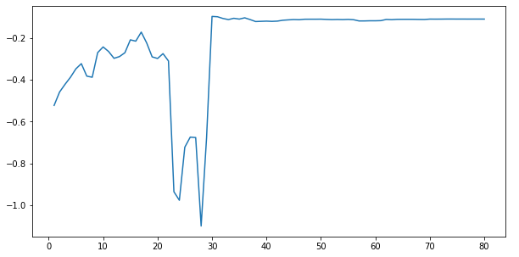
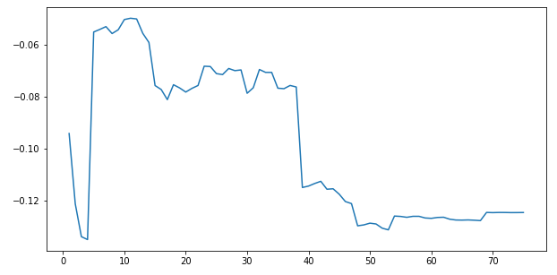
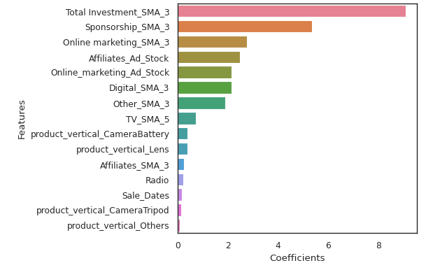
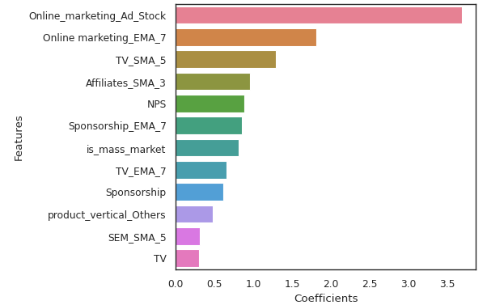
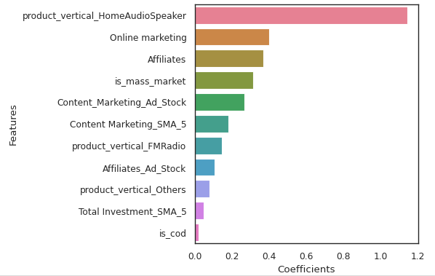
Additive Linear Regression
Simple Linear Regression for Camera Accessory
Simple Linear Regression for Gaming Accessory
Simple Linear Regression for Home Audio
Model Accuracy
R2 score - 0.701, MSE - 0.315
With K-fold Cross validation
Cross-Predicted Accuracy - 0.855, MSE - 0.145
Model Accuracy
R2 score - 0.865, MSE - 0.175
With K-fold Cross validation
Cross-Predicted Accuracy - 0.529, MSE - 0.471
Model Accuracy
R2 score - 0.993, MSE - 0.003
With K-fold Cross validation
Cross-Predicted Accuracy - 0.934, MSE - 0.066

Slide 21
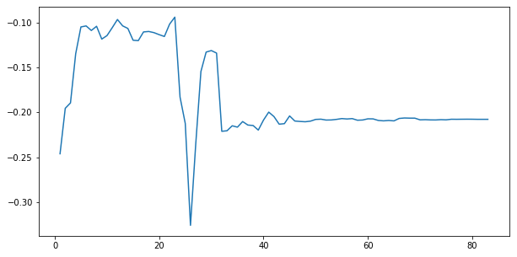
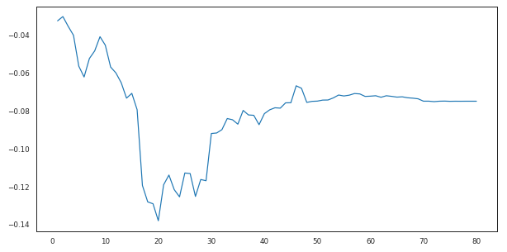
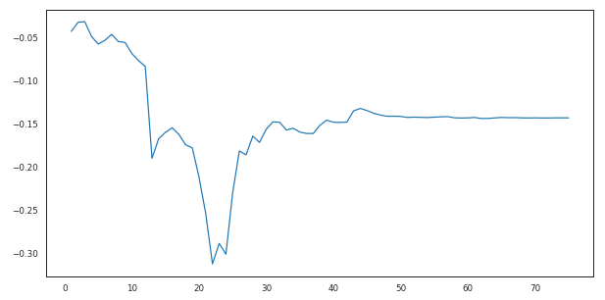
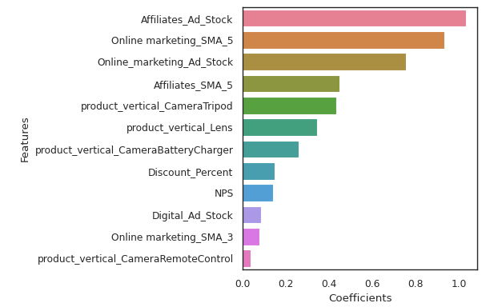
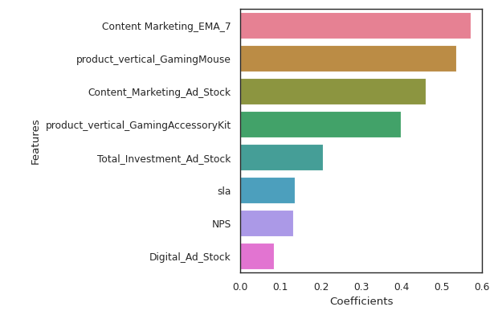
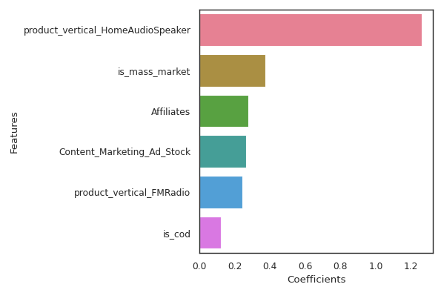
Multiplicative Linear Regression
Simple Linear Regression for Camera Accessory
Simple Linear Regression for Gaming Accessory
Simple Linear Regression for Home Audio
Model Accuracy
R2 score - 0.966, MSE - 0.162
With K-fold Cross validation
Cross-Predicted Accuracy - 0.842, MSE - 0.158
Model Accuracy
R2 score - 0.932, MSE - 0.120
With K-fold Cross validation
Cross-Predicted Accuracy - 0.832, MSE - 0.168
Model Accuracy
R2 score - 0.980, MSE - 0.584
With K-fold Cross validation
Cross-Predicted Accuracy - 0.975, MSE - 0.025

Slide 22
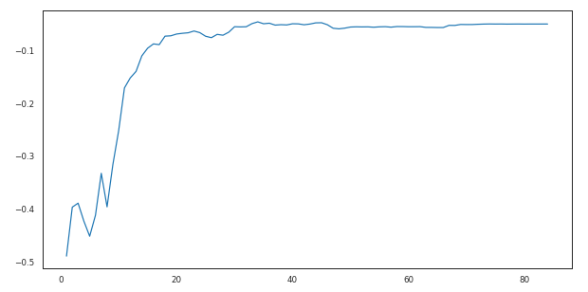
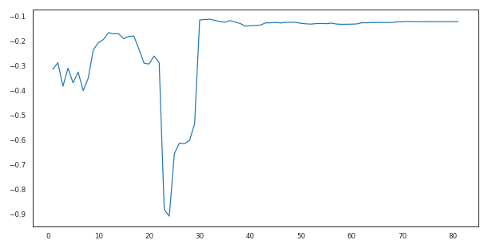
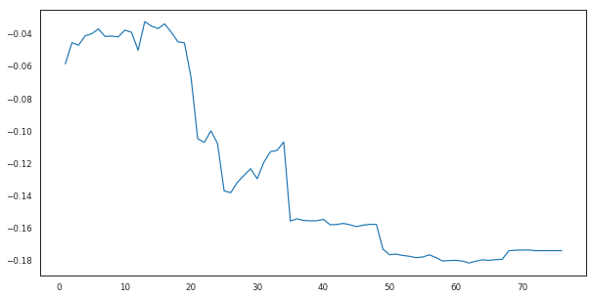
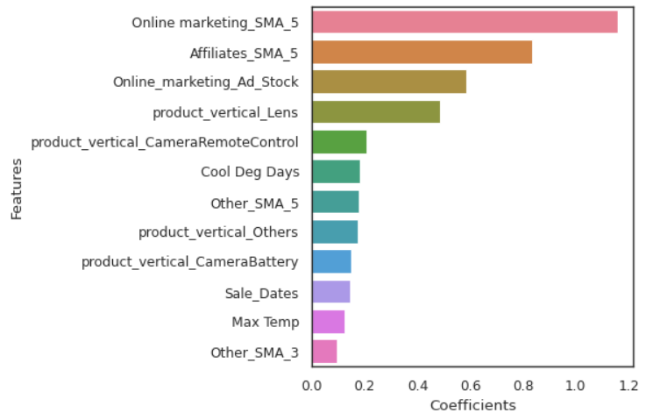
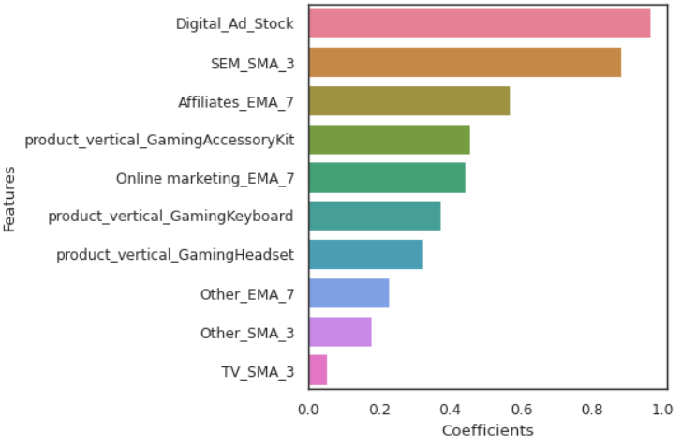
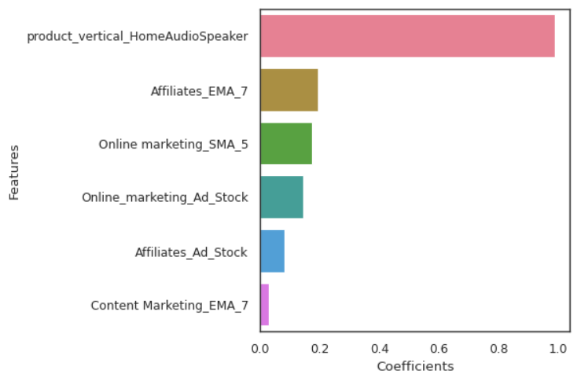
Koyck Model
Simple Linear Regression for Camera Accessory
Simple Linear Regression for Gaming Accessory
Simple Linear Regression for Home Audio
Model Accuracy
R2 score - 0.797, MSE - 0.214
With K-fold Cross validation
Cross-Predicted Accuracy - 0.909, MSE - 0.091
Model Accuracy
R2 score - 0.954, MSE - 0.059
With K-fold Cross validation
Cross-Predicted Accuracy - 0.935, MSE - 0.065
Model Accuracy
R2 score - 0.964, MSE - 0.017
With K-fold Cross validation
Cross-Predicted Accuracy - 0.835, MSE - 0.165

Slide 23
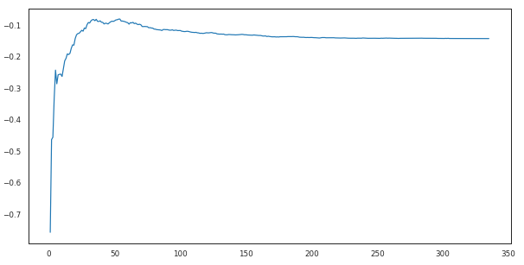
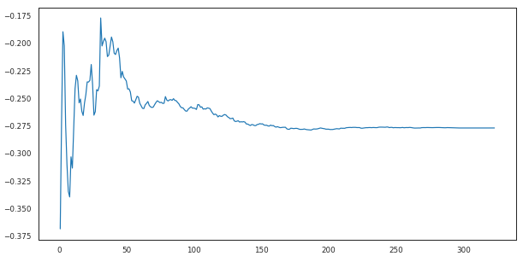
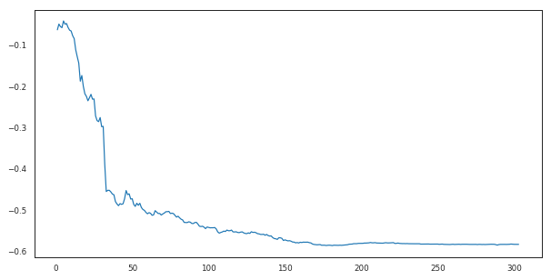
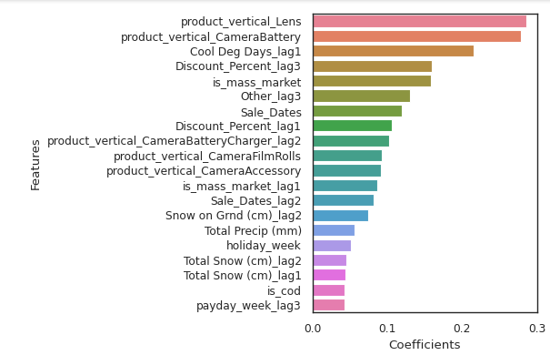
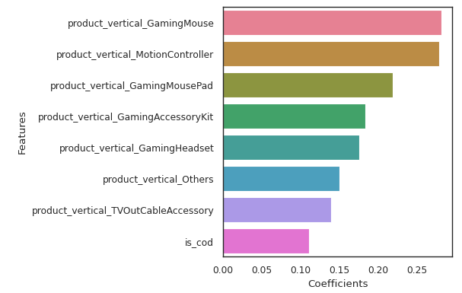
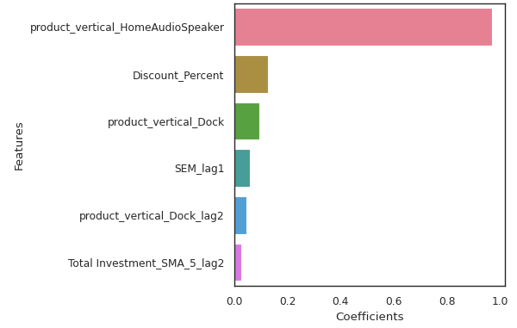
Distributed Lag Model - Additive
Simple Linear Regression for Camera Accessory
Simple Linear Regression for Gaming Accessory
Simple Linear Regression for Home Audio
Model Accuracy
R2 score - 0.675, MSE - 0.342
With K-fold Cross validation
Cross-Predicted Accuracy - 0.696, MSE - 0.304
Model Accuracy
R2 score - 0.965, MSE - 0.044
With K-fold Cross validation
Cross-Predicted Accuracy - 0.929, MSE - 0.071
Model Accuracy
R2 score - 0.929, MSE - 0.033
With K-fold Cross validation
Cross-Predicted Accuracy - 0.964, MSE - 0.036

Slide 24
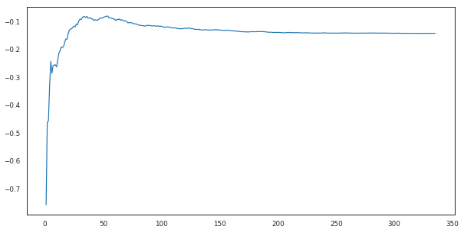
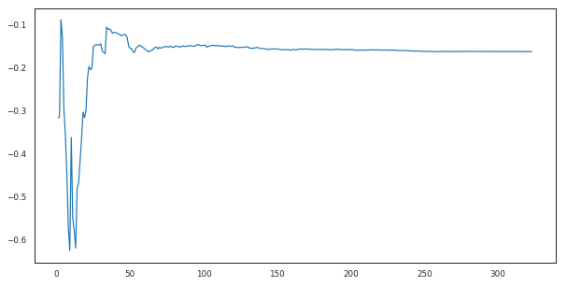
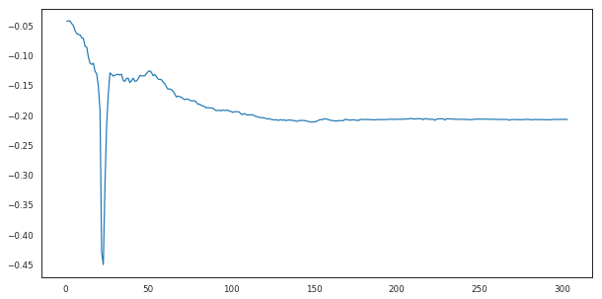
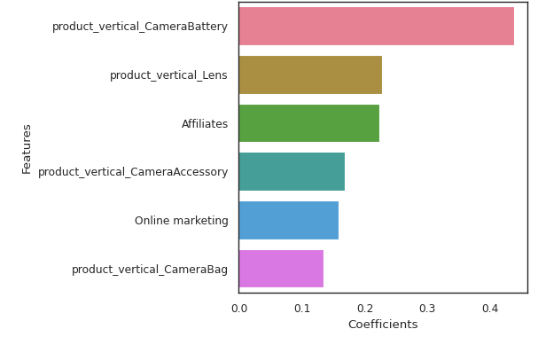
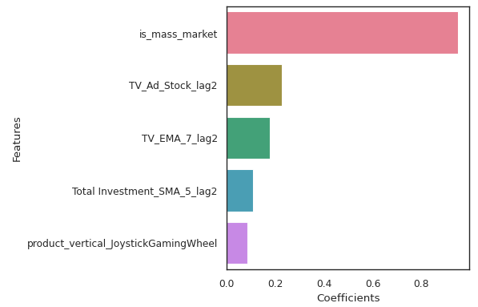
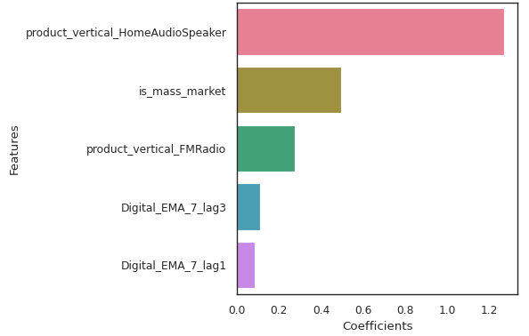
Distributed Lag Model - Multiplicative
Simple Linear Regression for Camera Accessory
Simple Linear Regression for Gaming Accessory
Simple Linear Regression for Home Audio
Model Accuracy
R2 score - 0.971, MSE - 0.138
With K-fold Cross validation
Cross-Predicted Accuracy - 0.897, MSE - 0.103
Model Accuracy
R2 score - 0.960, MSE - 0.071
With K-fold Cross validation
Cross-Predicted Accuracy - 0.897, MSE - 0.103
Model Accuracy
R2 score - 0.981, MSE - 0.565
With K-fold Cross validation
Cross-Predicted Accuracy - 0.979, MSE - 0.021

Slide 25
Model Evaluation and Recommendation

Slide 26
Product Sub-Category | Linear Regression Model | Cross Validation | R2 Score | MSE
Camera Accessory | Simple Linear Regression - Additive | No | 0.701 | 0.315
 |  | Yes | 0.855 | 0.145
 | Simple Linear Regression - Multiplicative | No | 0.966 | 0.162
 |  | Yes | 0.842 | 0.158
 | Koyck | No | 0.797 | 0.214
 |  | Yes | 0.909 | 0.091
 | Distributed Lag Model - Additive | No | 0.675 | 0.342
 |  | Yes | 0.696 | 0.304
 | Distributed Lag Model - Multiplicative | No | 0.971 | 0.138
 |  | Yes | 0.897 | 0.103
Gaming Accessory | Simple Linear Regression - Additive | No | 0.865 | 0.175
 |  | Yes | 0.529 | 0.471
 | Simple Linear Regression - Multiplicative | No | 0.932 | 0.12
 |  | Yes | 0.832 | 0.168
 | Koyck | No | 0.954 | 0.059
 |  | Yes | 0.935 | 0.065
 | Distributed Lag Model - Additive | No | 0.965 | 0.044
 |  | Yes | 0.929 | 0.071
 | Distributed Lag Model - Multiplicative | No | 0.96 | 0.07
 |  | Yes | 0.897 | 0.103
Home Audio | Simple Linear Regression - Additive | No | 0.993 | 0.003
 |  | Yes | 0.934 | 0.066
 | Simple Linear Regression - Multiplicative | No | 0.98 | 0.584
 |  | Yes | 0.975 | 0.025
 | Koyck | No | 0.964 | 0.017
 |  | Yes | 0.835 | 0.165
 | Distributed Lag Model - Additive | No | 0.929 | 0.033
 |  | Yes | 0.964 | 0.036
 | Distributed Lag Model - Multiplicative | No | 0.981 | 0.565
 |  | Yes | 0.979 | 0.021

Slide 27
Model Selection
Product Sub-Category | Linear Regression Model | Cross Validation | R2 Score | MSE | Top 5 KPIs
Camera Accessory | Koyck Model | Yes | 0.909 | 0.091 | Online marketing_SMA_5
 |  |  |  |  | Affiliates_SMA_5
 |  |  |  |  | Online_marketing_Ad_Stock
 |  |  |  |  | product_vertical_Lens
 |  |  |  |  | product_vertical_CameraRemoteControl
Gaming Accessory | Koyck Model | Yes | 0.935 | 0.065 | Digital_Ad_Stock
 |  |  |  |  | SEM_SMA_3
 |  |  |  |  | Affiliates_EMA_7
 |  |  |  |  | product_vertical_GamingAccessoryKit
 |  |  |  |  | Online marketing_EMA_7
Home Audio | Distributed Lag Model - Multiplicative | Yes | 0.979 | 0.021 | product_vertical_HomeAudioSpeaker
 |  |  |  |  | is_mass_market
 |  |  |  |  | product_vertical_FMRadio
 |  |  |  |  | Digital_EMA_7_lag3
 |  |  |  |  | Digital_EMA_7_lag1

Slide 28
Recommedations
General
Most of the sales take place when Discount% is between 50-60%. However, that does not necessarily help in boosting the revenue. EDA shows that an average discount% between 10-20% is the most profitable for the company specially among luxury items.
Camera Accessory
Company should promote Lens, Binoculars, and Camera Batteries as they fetch the highest revenue.
Advertisement spends on Online Marketing and Affiliates marketing has a positive impact on revenue. So this type of marketing should be encouraged. (Referred from Koyck Model)
Mass-market products are better contributors to the increased revenue in comparison to the Luxury products.
Gaming Accessory
Company should promote GamePad, Gaming Headset, and Gaming Mouse as they fetch the highest revenue.
Digital marketing and Search Engine marketing have more impact on revenue. So this type of marketing should be encouraged. (Referred from Koyck Model)
Mass-market products are better contributors to the increased revenue in comparison to the Luxury products.
Home Audio
Company should promote Home Audio Speakers, FM Radios, and Voice Recorder as they fetch the highest revenue.
Online marketing has a positive impact on revenue. (Referred from Koyck Model)
In this sub-category, the highest revenue is generated in the discount range of 50-60%
Mass-market products are better contributors to the increased revenue in comparison to the Luxury products.
For Home Audio, customers prefer to pay before they receive the products

Slide 29
Appendix

Slide 30
Data Cleaning
GMV should be less than or equal to Product_mrp * Units i.e. gmv <= product_mrp * units.
The mrp values that do not satisfy the above mentioned condition will be imputed with gmv/units (assumption that discount % is 0)
Fixing Invalid Values
Sanity checks
Checking whether the month and year given in the order date is same as the month and year given in the respective columns
Dropping columns with missing values more than 50%,
The columns deliverybdays and delivercdays have 79.63% of missing values. It will not be sensible to impute deliverybdays and delivercdays missing values with 0 for 79.63% values especially when sla is much more for these same orders.
Since GMV is the dependent variable, we must not have missing values for it, we can either impute or remove records where GMV value is missing. Since the missing values are much less as compared to total records, it is safe to remove them without affecting overall statistics
Checking product_analytic_vertical column missing values
These null values are actually not missing values but a vertical '\N' under 'EntertainmentSmall' category and 'Speaker' subcategory. We will impute the value '\N' with 'Others'.
Treating Missing Values

Slide 31
Data Pre-processing
Product_mrp - removing values where product mrp is 0
GMV - Imputing gmv(dependent variable) might affect the analysis. It is safe to drop these records.
SLA - SLA > 60 doesn't make sense and is impractical for an ecommerce firm and should be handled while treating outliers
product_procurement_sla being negative or 1000 doesn't make sense. The negative values can be handled by dropping them.
Pre-processing of numerical columns
Product_analytic_super_category - Since there is only 1 unique value in this column, it doesn't add any information and should be dropped
Removing scientific notations in customer id, order id, order item id, and pincode
Pre-processing of categorical columns
Removing duplicates
Removing columns that will not be used - eg. fsn_id, cust_id, pincode
Removing data where date is out of the required analysis
Removing duplicates and unnecessary data

Slide 32
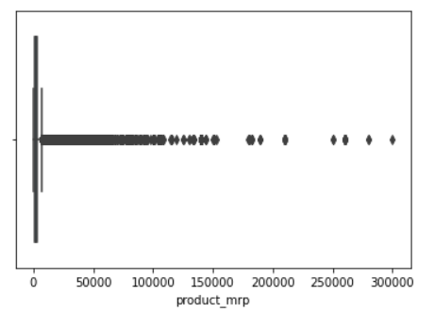
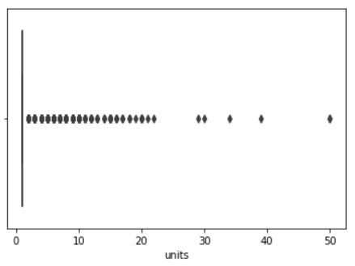
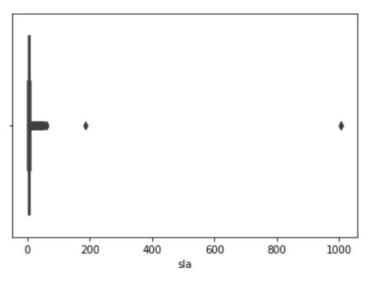
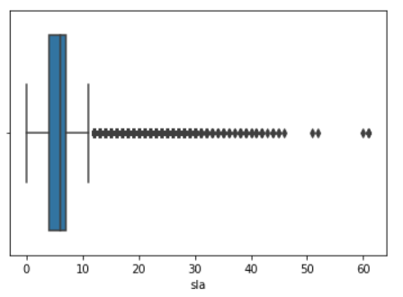
Outlier Treatment
Product MRP: We can drop the outliers (product_mrp > 155000) as it may bias the model. Also, the number of records are negligible as compared to total records, so we won’t lose a lot of data
Units: Sometimes there might be cases where products are bought in large numbers. Since gmv values for these records is low, we do not need to drop them. Also units might not be considered when modelling, so keeping them also won’t have a lot of impact.
SLA: We can drop sla>180 as shown in the first figure. The second box plot shows that even even sla>60 is a lot when business is concerned for an ecommerce firm. This might skew our data. Removing them is a good.

Slide 33
Prepare Other Datasets
Media Investment
Removed Null values and modified the data weekwise
Created new KPIs
SMA (Simple Moving Average) and EMA (Exponential Moving Average) for each of the three subcategories and total SMA and EMA for 3, 5, and 7 weeks
Adstock - Calculating the adstock for each of the advertising media. The formula for adstock is At = Xt + adstock rate * At-1
Sale Data
Removed Null values and modified the data to extract the range of sale dates in 2015 and 2016
Extracted number of Sale days in a particular week
NPS & Stock Index Data
Cleaned the data and removed Null values
Kept the same value of NPS score and Stock Index for each week in a particular month
Climate Data
Handled missing values - Dropped rows where most of the columns have nulls. Since this is weather data, it is difficult to impute anything. So, it is safe to remove these rows.
Extracted week from date and grouped the data on the basis of the week
Performed the above two steps separately for 2015 and 2016 and then merged the data for the two years

Slide 34
Merge other datasets with Consumer Data
New KPI creation
Payday Week - If it is a Payday week then 1 else 0
Holiday Week - If it is a holiday week then 1 else 0
Extracting 3 separate dataframes for each product subcategory from main consumer electronics dataframe
Extract Weekly data for CameraAccessory, GamingAccessory and HomeAudio dataframes
1
2
3
4
5
1
2
3
4
5
Creating Dummy variables for main consumer electronics dataframe
Merging with other dataframes
Media Investment Weekly Data
Sale Calendar
NPS and Stock Index weekly
Climate Data

